Slide 1

Automatic Composition in IoT Systems
Yehia Elkhatib
Notes:
philosophy: user control without pain
high level requirements
cloud computing, network intents, system composition

Slide 2
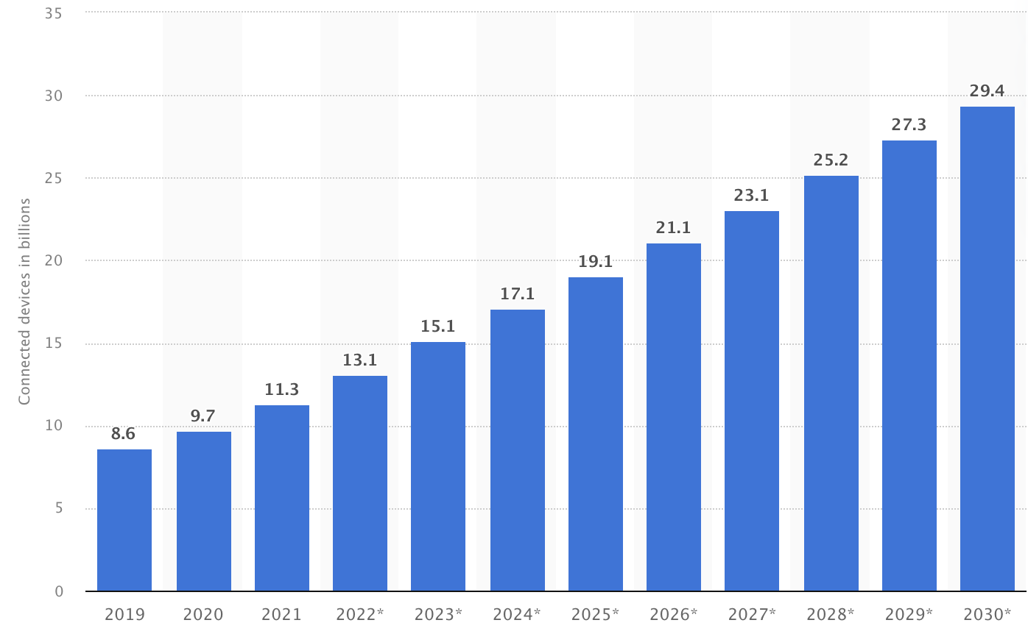
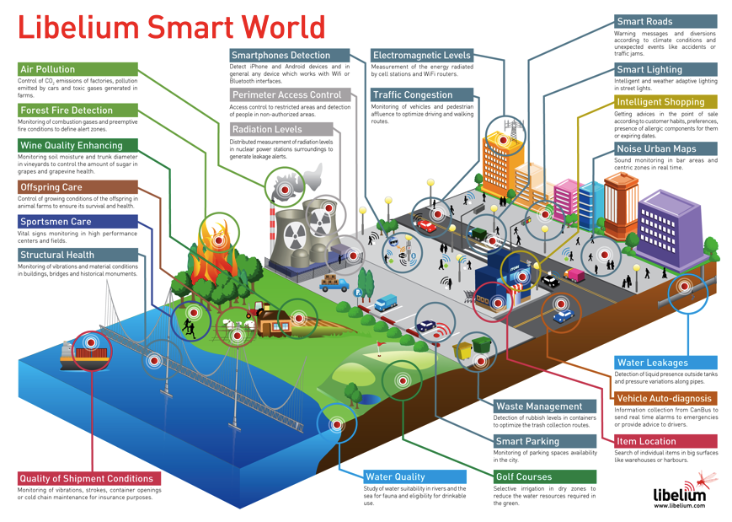
The Rise in IoT Uptake
Technological advances
system-on-chip design and manufacturing
devices are highly available, affordable, small, power-efficient
network connectivity: LTE, 5G, WiFi, Zigbee, LoRaWAN
Great progress in deploying applications over various fabrics
in situ sensing and actuating devices
Lots of interesting verticals
https://www.statista.com/statistics/1183457/iot-connected-devices-worldwide/
https://www.libelium.com/libeliumworld/top_50_iot_sensor_applications_ranking/
Notes:
this is a problem we started working on many years ago, problem still persists
smart city: maybe a municipality wants to plan optimal waste collection schedule... so need to take into consideration vehicle and foot traffic; track bus and tram locations; air pollution levels...

Slide 3
Problem Statement
A variety of constituent systems
independently deployed
use proprietary APIs + data formats
co-exist in shared physical spaces
Challenge:
heterogeneity makes it difficult to design, maintain and adapt integrated systems
system developers are overwhelmed with the amount of knowledge they need to acquire
difficult to future-proof applications for opportunistic interaction with other systems
Notes:
gives us an interesting challenge
previous DS middlewares not suitable
e.g. CORBA, Jini require developers to bake in service description into their code using IDL

Slide 4
Approach Overview
Can we get IoT systems to talk to each other post-deployment?
Yes, with a bit (lot!) of effort
How?
Create a means to describe systems
Describe systems
Discover systems
Reason about composition
oh! and get users to write abstract workflows
…and sometimes we need to deploy mediators
Still more work to do?
Always
Notes:
TL;DR

Slide 5
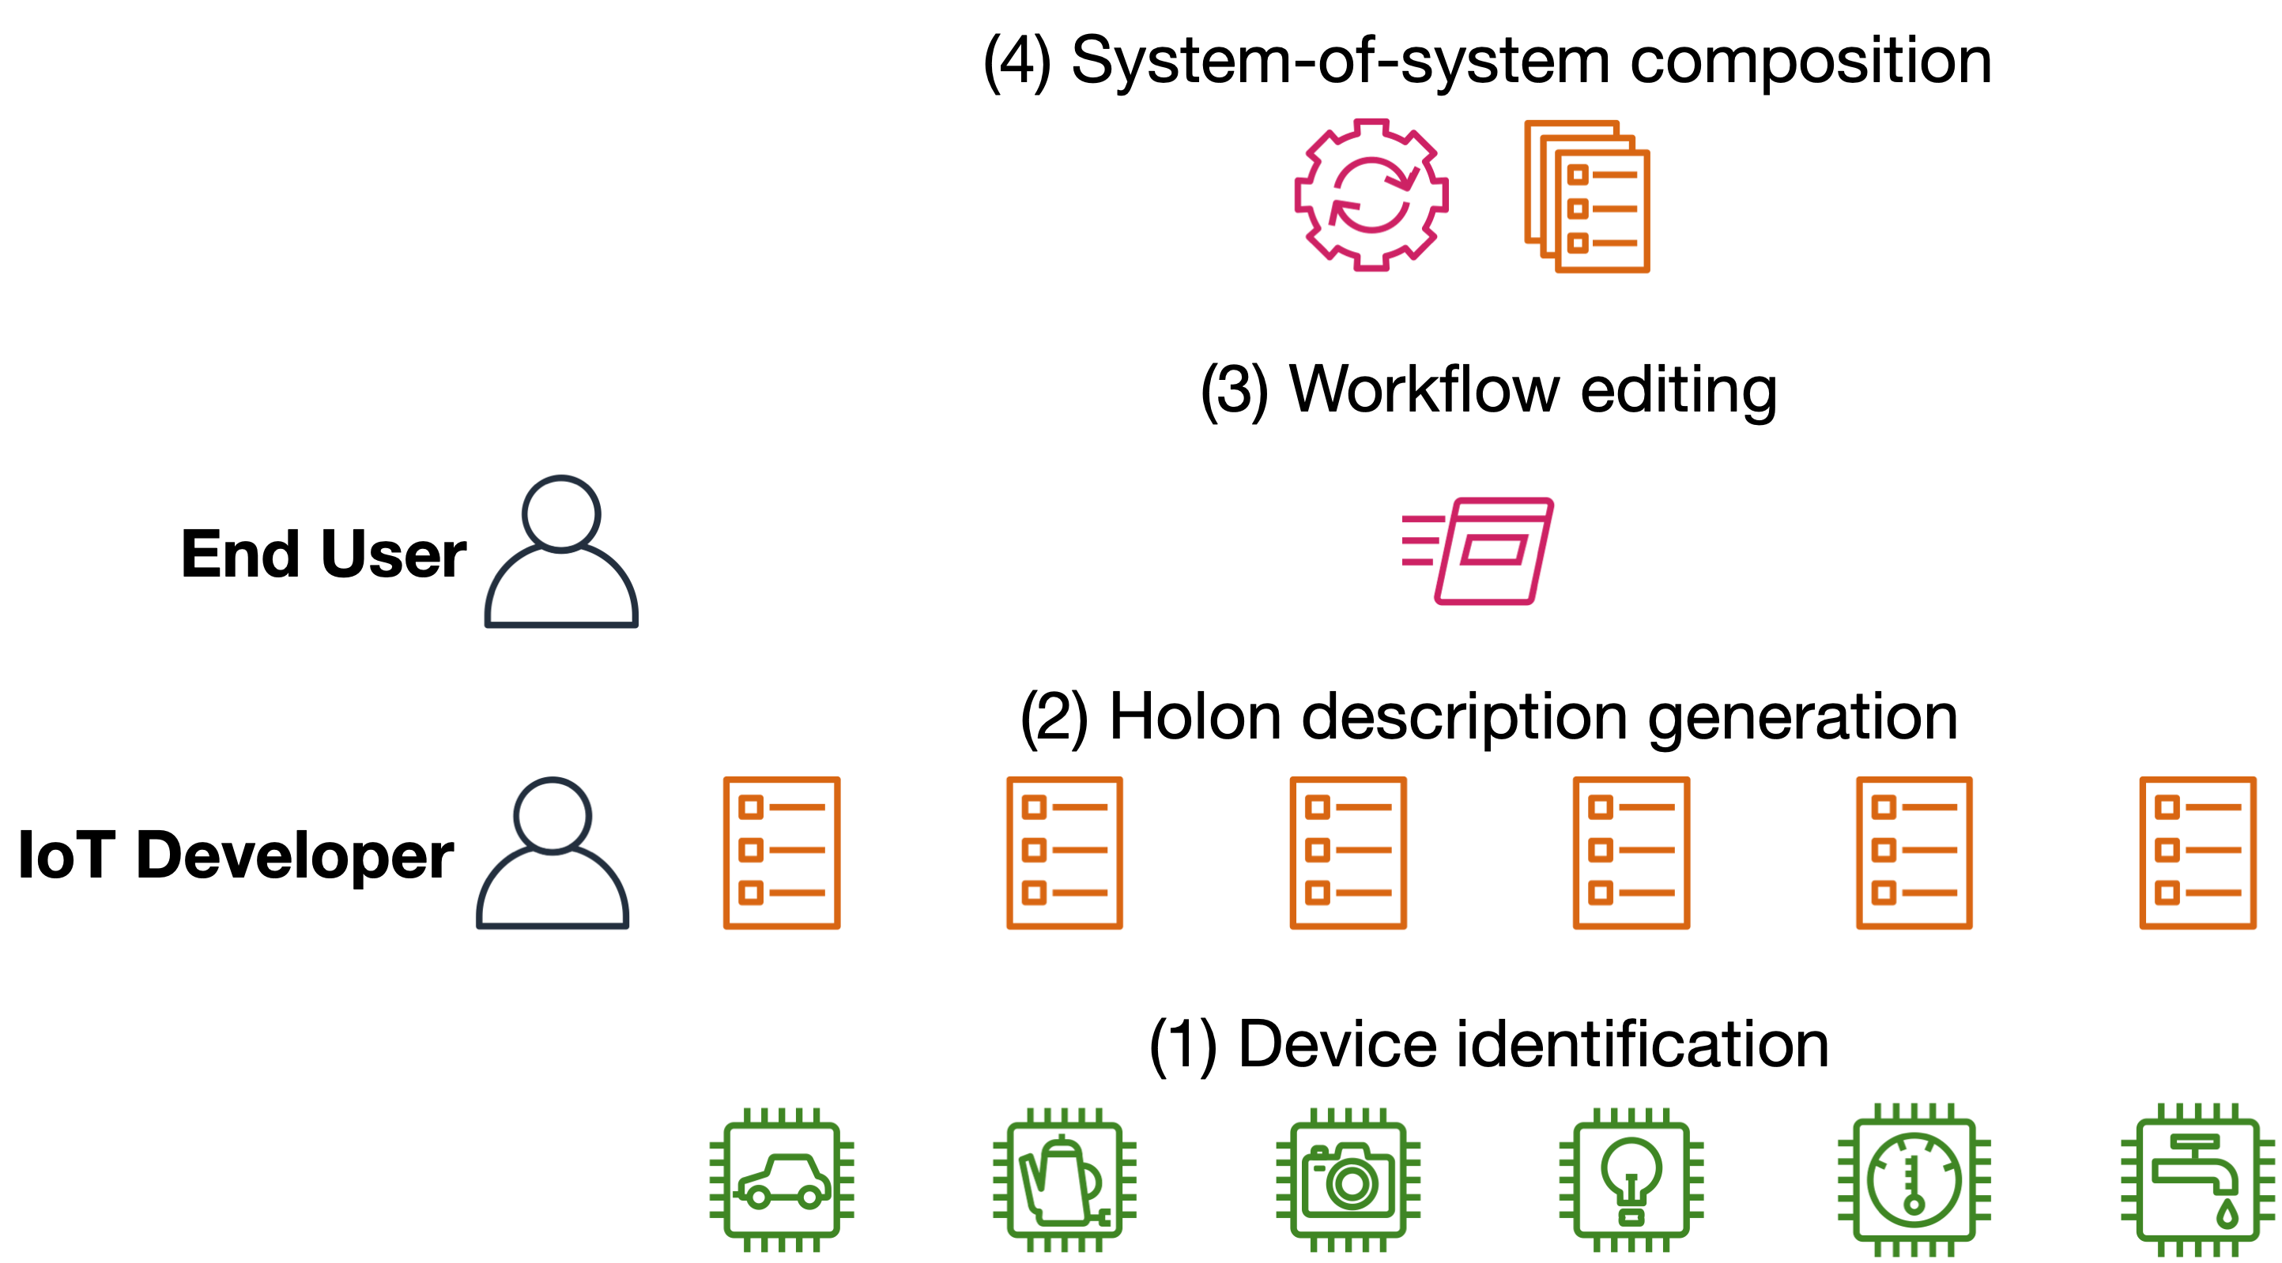
High-level Vision
[SEAMS’20, FGCS’24]
[IoT’22]
[FiCloud’22, ICWS’23]
[ARM’15, ICIoT’20]
Notes:
peeling the onion

Slide 6
Problem and Solution
Vendor
Developer
System
API Specification
API Understanding
SoS Running
SoS Design
Classical approach
SoS Composition
Application Deployment

Slide 7
Problem and Solution
Vendor
Developer
System
API Specification
API Understanding
SoS Running
SoS Design
Classical approach
SoS Composition
Application Deployment
*
Holon Specification
Abstract workflow specification
Holon discovery and understanding
Holon approach
Holon deployment
SoS Composition
Workflow deployment
Notes:
* or maybe post-market. but we have explored ways of lowering this expectation
whistle-stop tour

Slide 8
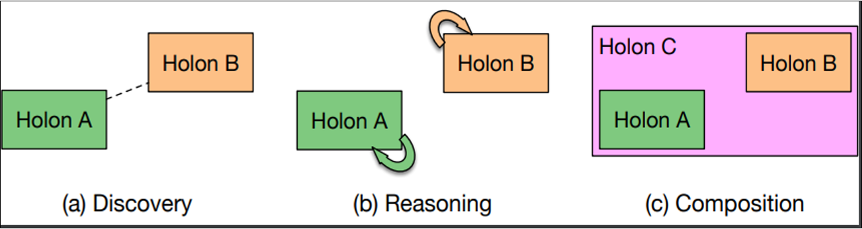
Holon?
A holon is a self-describing system that appears as a whole when viewed from above whilst potentially comprising multiple subsystems when viewed from below
A holon is described using an ontology that can be
advertised
discovered
used to reason about opportunistic composition
Notes:
Introduced by Arthur Koestler, the term “holon” refers to a philosophical concept describing entities that are simultaneously whole in themselves and parts of larger systems
goals:
generality
opportunistic interaction
declarative programmability
low runtime overhead

Slide 9
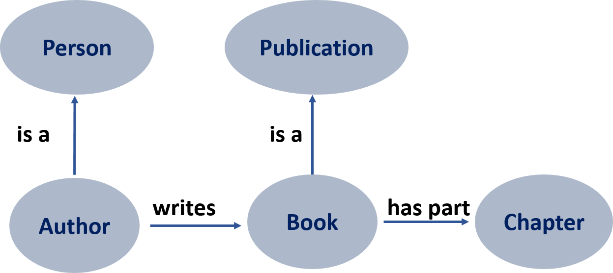
What is an ontology?
An ontology is an abstract model of the world, or some domain
An ontology introduces a vocabulary that is relevant to the domain
Explicitly defines concepts, properties, relations, and constraints

Slide 10
Specifying a Holon
HOLON:
has parent (holon); has children (holons); supports services
Membership properties: has Children, is Member
Physical properties: power level; location; mobile; firmware; …
SERVICE:
requires properties; desires properties; guarantees properties; may provide properties; exposes API
PROPERTY: (domain-specific)
e.g. smart home: sensing temperature, humidity, motion; data storage; controlling climate, doors, windows, curtains; …
Notes:
high-level classes

Slide 11
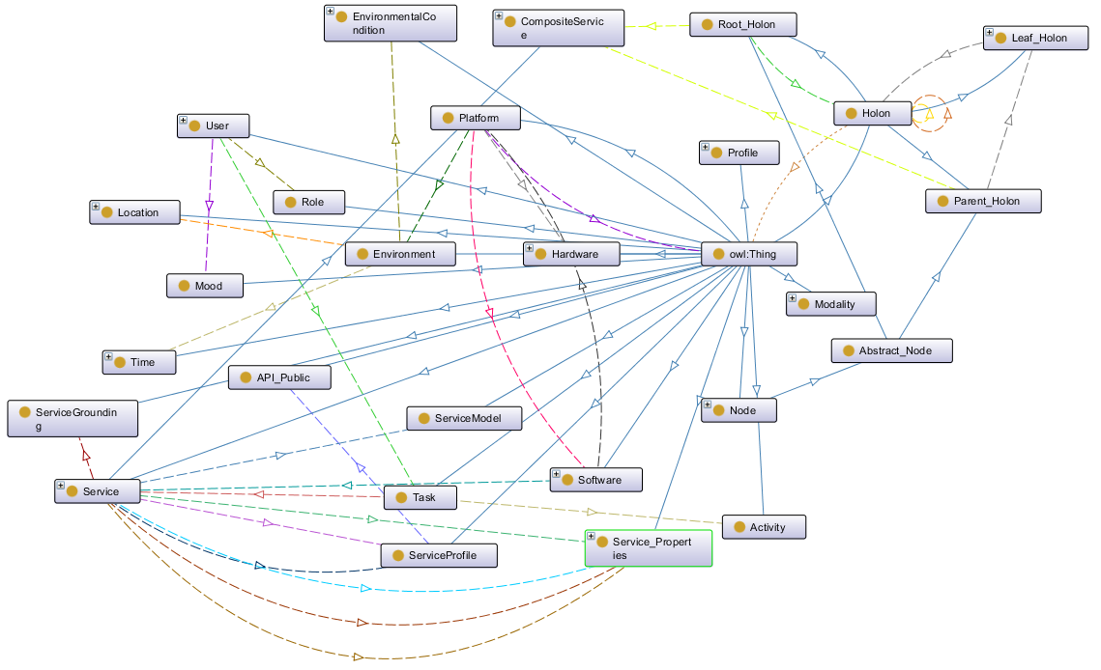
Notes:
Full metamodel

Slide 12
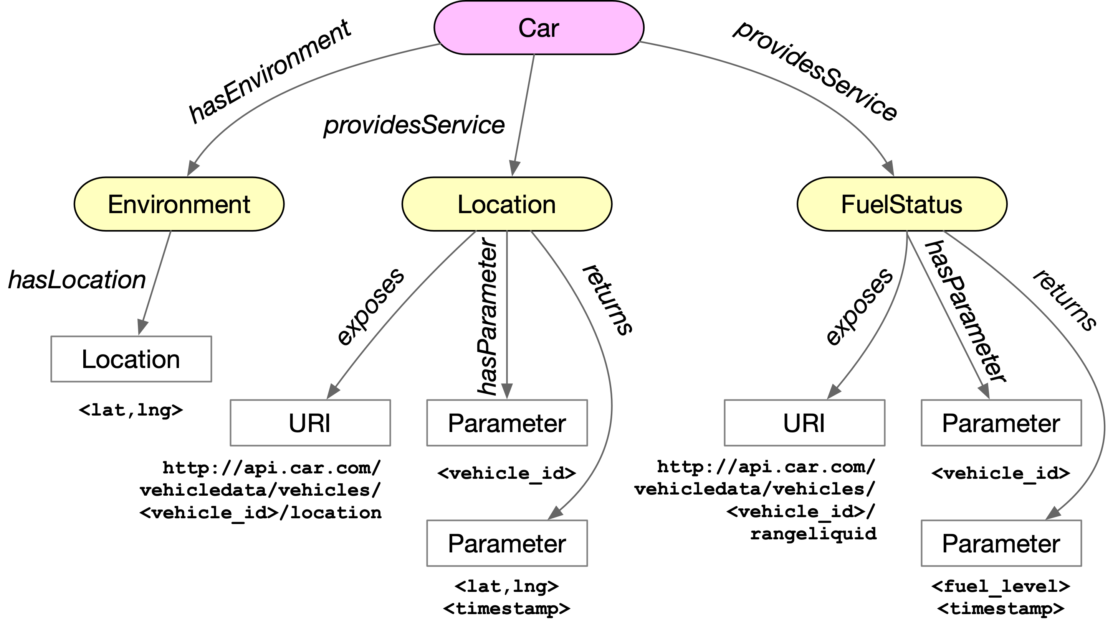
Notes:
has properties and provides services

Slide 13
Composition
The composition model is represented as a weighted tree of depth three
Me
Level 1: The holon itself
H1
H2
H3
Level 2: Holons that are directly reachable by the root holon
F1
F2
F3
F2
F4
F5
F6
Level 3: Detected functionalities
1
2
2
3
1
1
8
Cost of accessing the functionality
Notes:
our first go at this… Level 1: the holon itself
Level 2: Holons that are directly reachable by the root holon
Level 3: Detected functionalities that are provided by or accessed through other holons.
Each leaf node is assigned a weight that represents the cost of accessing the corresponding functionality.

Slide 14
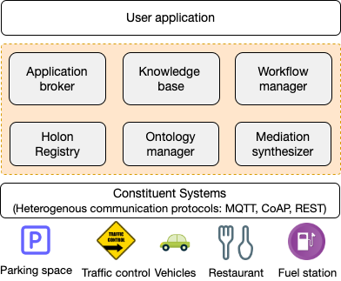
Hetero-Genius Architecture
allows the user application to interact with the integrated system
converts an abstract workflow to an executable one by selecting services
storing, looking up and aggregating systems
discover mismatch between messaging protocols at runtime
a runtime for creating (o/p) and parsing (i/p) ontologies
an ontological specification of properties, functionalities, and binding information
Notes:
arch mark 2: to discover, reason, compose, mediate
placement of a mediator is an optimization problem in its own right
KB: data repository storing real-time info about constituent systems

Slide 15
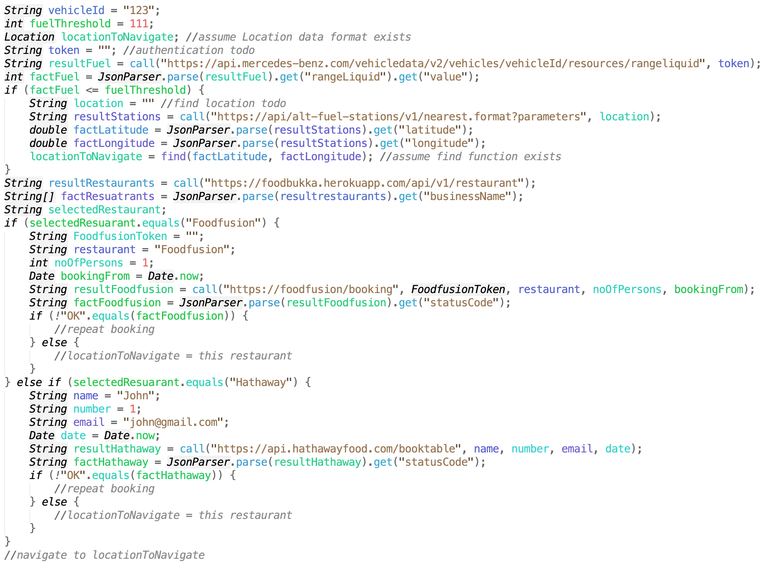
Sample Response – Classical

Slide 16
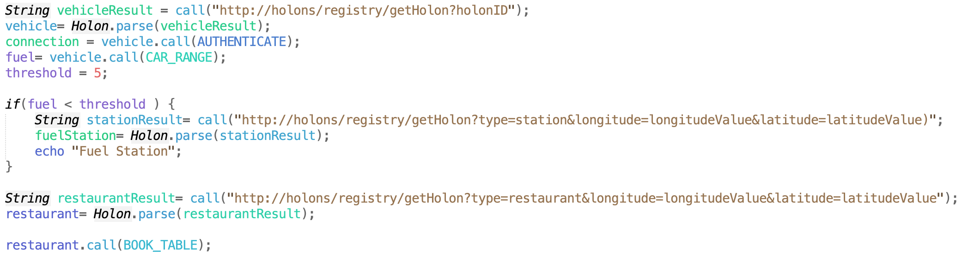
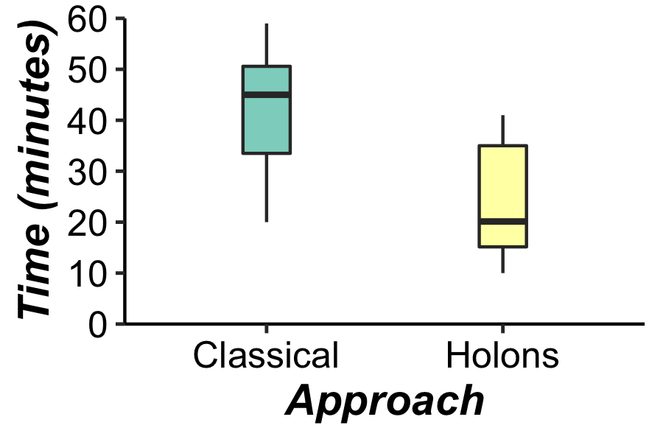
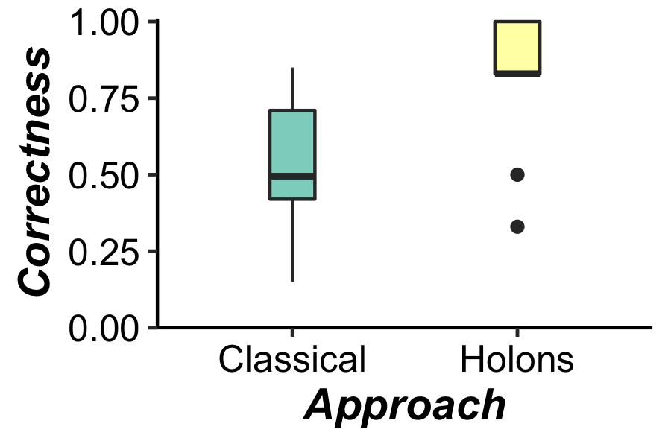
Sample Response – Holon DSL
55%
47%
Notes:
improve productivity by 47%
improve correctness by 55%

Slide 17
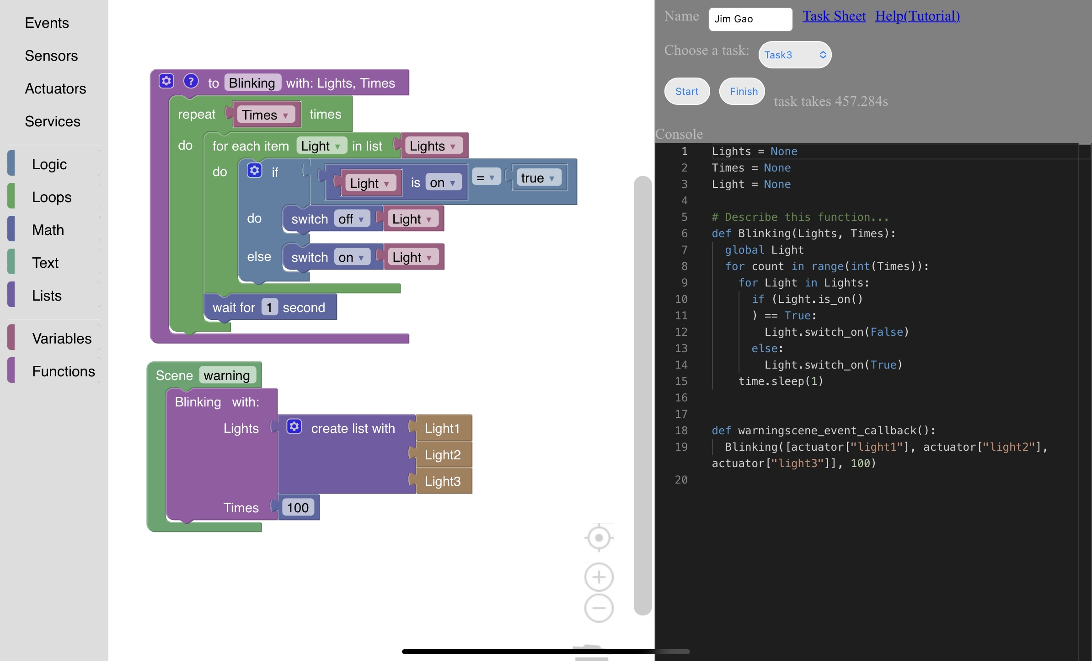
Graphical Workflow – HolonCraft

Slide 18
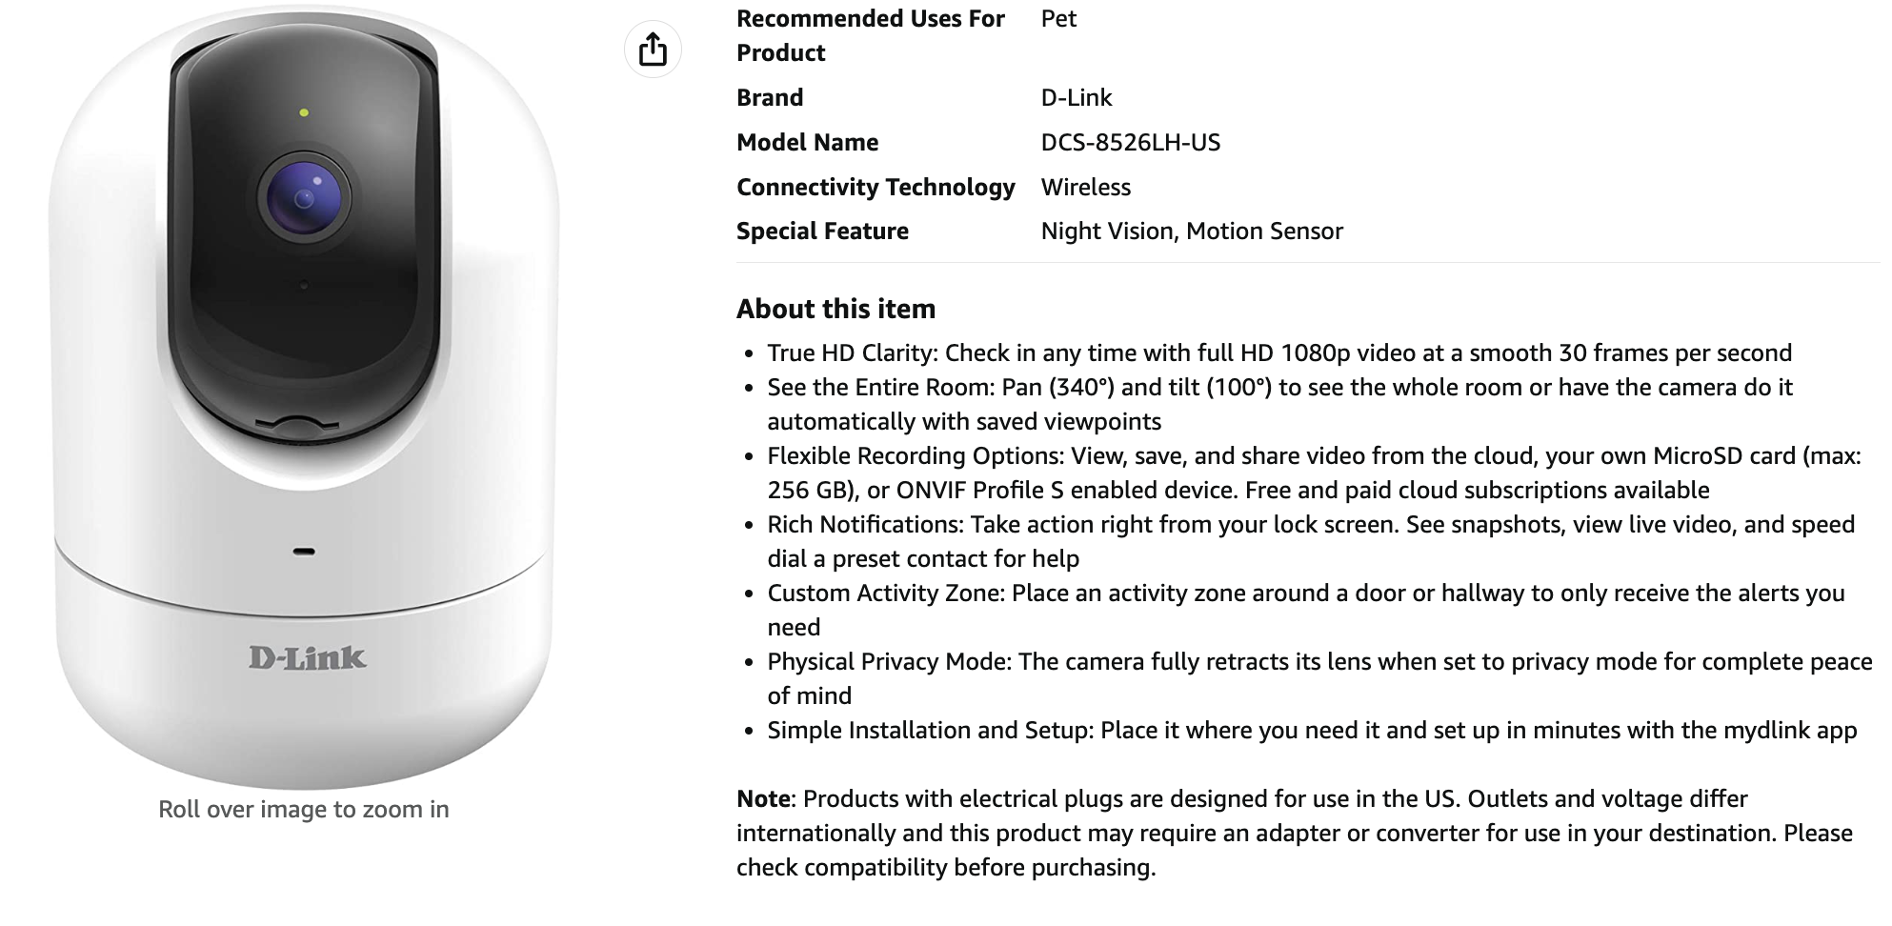
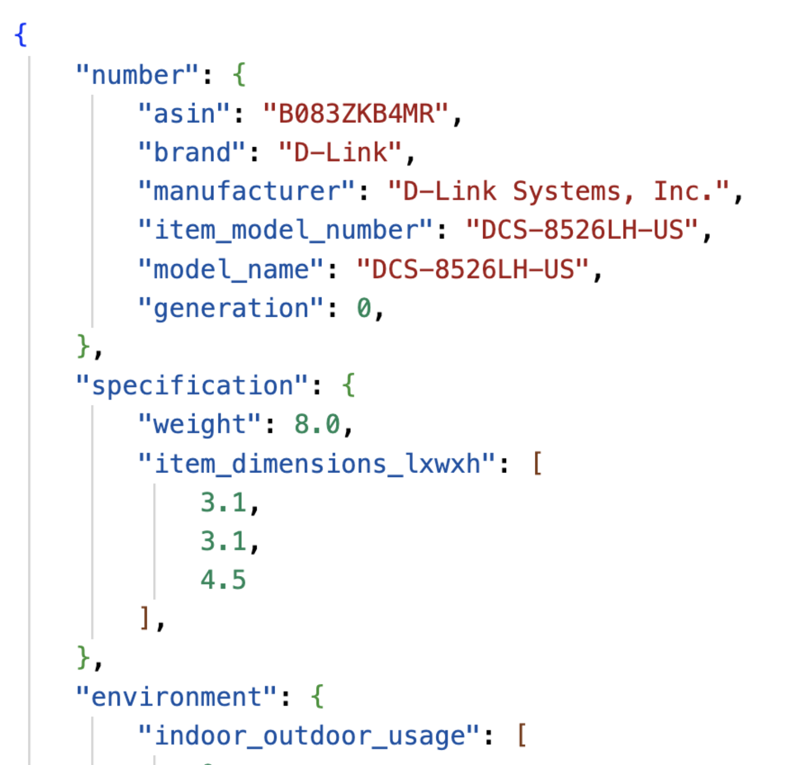
Knowledge Extraction
Parameters
Key-value pairs that include parameters and device properties
Functional Description
Several paragraphs of unstructured text, describing the functions of the device
Notes:
you can identify an IoT device from 1-second worth of its DNS traffic

Slide 19
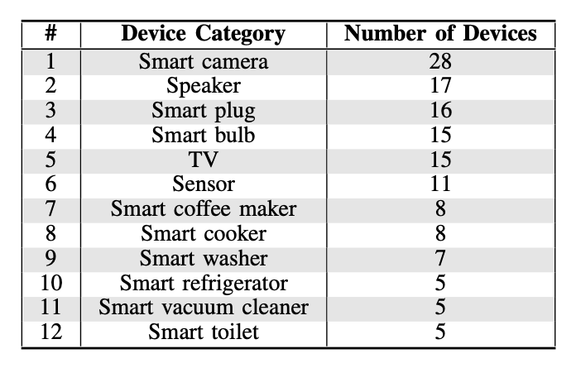
Knowledge Extraction
Robustly optimized BERT approach (RoBERTa), a model using the Stanford Question Answering Dataset (SQuAD.0)
Experiment on 140 devices
Learning rate: 5e-5
Batch size 32, Epoch 20
 | Precision | Recall | F1
Parameter | 98.17% | 94.81% | 96.11%
Function description | 94.64% | 78.00% | 84.19%
Overall Holon description | 96.72% | 87.53% | 91.90%
Notes:
To form the dataset, we find 140 of the popular smart home devices in Europe and the US from the Internet.
devices span 12 different smart home categories
BERT: Bidirectional Encoder Representations from Transformers
dataset split 80/20
learning rate: controls how much the model's weights are updated based on the errors it makes during training. It essentially determines the step size the model takes when moving towards minimizing the loss function.

Slide 20

References
https://yelkhatib.github.io/
[ARM’15] Gordon Blair, Yérom-David Bromberg, Geoff Coulson, Yehia Elkhatib, Laurent Réveillère, Heverson B. Ribeiro, Etienne Rivière, and François Taïani, “Holons: Towards a Systematic Approach to Composing Systems of Systems”, Workshop on Adaptive and Reflective Middleware, 2015.
[ICIoT’20] Vatsala Nundloll, Yehia Elkhatib, Abdessalam Elhabbash, and Gordon S Blair, “An Ontological Framework for Opportunistic Composition of IoT Systems”, International Conference on Informatics, IoT, and Enabling Technologies (ICIoT), IEEE, pages 614-621, February 2020.
[SEAMS’20] Abdessalam Elhabbash, Vatsala Nundloll, Yehia Elkhatib, Gordon S Blair, and Vicent Sanz Marco, “An Ontological Architecture for Principled and Automated System of Systems Composition”, International Symposium on Software Engineering for Adaptive and Self-Managing Systems (SEAMS), July 2020.
[FiCloud’22] Zhuo Wang, Yehia Elkhatib, and Abdessalam Elhabbash, “HolonCraft -- An Architecture for Dynamic Construction of Smart Home Workflows”, International Conference on Future Internet of Things and Cloud (FiCloud), IEEE, pages 213-220, August 2022.
[IoT’22] Abdessalam Elhabbash, Yehia Elkhatib, Georgios Bouloukakis, and Maria Salama, “A Middleware for Automatic Composition and Mediation in IoT Systems”, International Conference on the Internet of Things (IoT), ACM, pages 127–134, November 2022.
[ICWS’23] Ziyu Zhang, Yehia Elkhatib, and Abdessalam Elhabbash, “NLP-based Generation of Ontological System Descriptions for Composition of Smart Home Devices”, International Conference on Web Services (ICWS), IEEE, July 2023.
[FGCS’24] Abdessalam Elhabbash, Yehia Elkhatib, Vatsala Nundloll, Vicent Sanz Marco, and Gordon S Blair, “Principled and Automated System of Systems Composition using an Ontological Architecture”, Future Generation Computer Systems, Elsevier, 2024.

Slide 21






Challenges
IoT-motivated ontology
Evaluated in contexts like smart home, IoV, etc.
Cross ecosystem boundaries
Discovery through announcement
Architecture relies on systems advertising themselves
Passive discovery still possible, but more challenging
Trust
Assume that it is safe to compose
Assume that we are not compromising inherent system
Notes:
Marie Curie: "One never notices what has not been done” – happy to add to this list
cross-ecosystem: smart home, smart car, wifi router, mobile devices, etc.
started doing unplanned disaster rescue
SOA does not capture physical properties, and still high pre-knowledge required
smart city: monitor vehicle and foot traffic; track bus and tram locations; monitor air pollution => plan optimal waste collection schedule
Thanks for your attention!

Slide 22
here be backup slides

Slide 23
FAQ/Cs
You can’t have “one ontology to rule them all”
just one means, with a tradeoff between generality and usefulness
overhead is not insurmountable as evidenced by our experiments
we do not expect manufacturers to change anything
Developer overhead still too high, e.g. end users
developed an approach using graphical programming [FiCloud’22]
developed NLP method to automatically generate Holon descriptions [ICWS’23]

Slide 24
Research Focus
Aim:
allow IoT development at a high-level as an abstract workflow
enable automated opportunistic construction and mediation in IoT contexts
Objectives:
design development tools for high-level application logic
identify independent systems with their unique characteristics
recognize the need to compose with other systems
detect the need for mediation logistics
set in action any support roles needed to actuate mediation

Slide 25
Approach
Apply the concept of holons to represent systems recursively
Build an architecture for automated composition of holons
discover other systems and their services
opportunistically compose with them to satisfy a user request
detect the need for mediation
create mediators at runtime for direct interaction with other systems

Slide 26
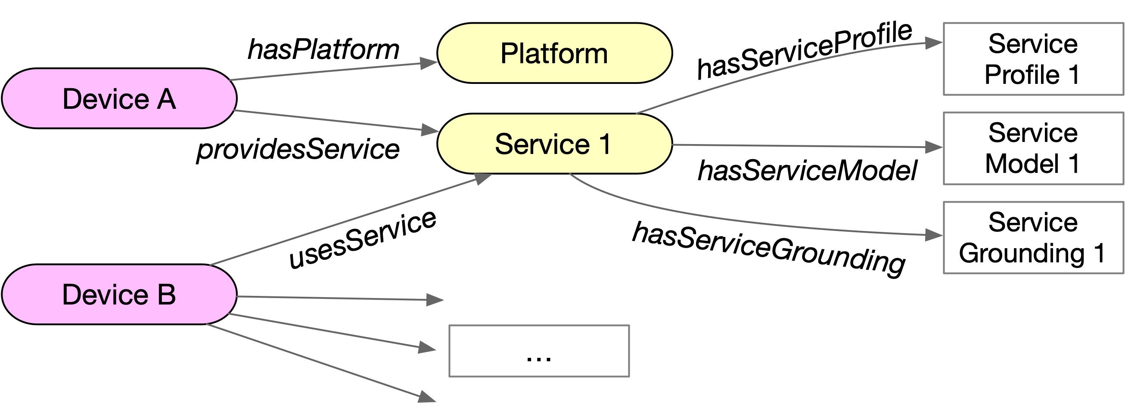

Slide 27
Concertizing an Abstract Workflow
Find physical systems that provide the required services
Broker queries the Registry for descriptions of suitable systems
Broker verifies the response to match:
the annotations of the required services (specified in the workflow), with
the annotations of the provided services (specified in the system’s holon)
Return the binding information of each service to the user application, along with messaging info (API, protocol)

Slide 28
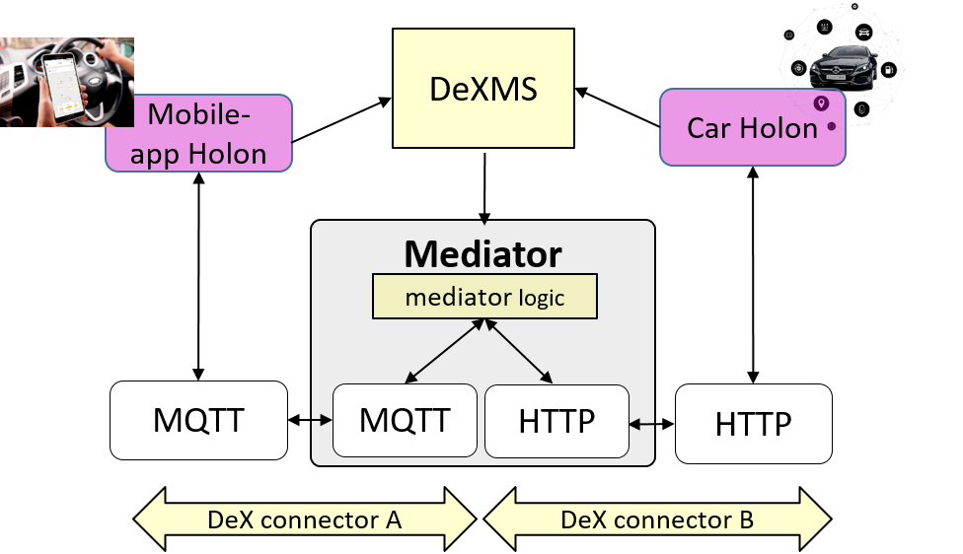
Addressing Interoperability
Systems have different protocols, data-serialization formats, and interaction paradigms
Broker can detect this from holon descriptions
We use the Data eXchange Mediator Synthesizer (DeXMS), which creates bridges between divergent systems
Georgios Bouloukakis, Nikolaos Georgantas, Patient Ntumba, and Valérie Issarny, “Automated Synthesis of Mediators for Middleware-layer Protocol Inter- operability in the IoT”, Future Generation Computer Systems 101 (2019), 1271 – 1294, 2019.
Notes:
we would love all IoT systems to use the same formats and protocols, but history tells us that this will not happen
keeps me in a job working on interoperability
DeXMS (Python) extends NodeRED (Javascript) – visual prog for wiring hardware and APIs

Slide 29
Evaluation – Overview
Aim to measure:
Productivity – time required to develop application logic
Correctness – adherence to usage of correct APIs
Strategy: user experiments from an IoV context
stop for food (and fuel?) on a car journey
4 systems:
car – provides fuelStatus, location
fuel station – provides location
restaurant – provides menu, details (location, contact details, etc)
traffic control unit (TCU) – provides trafficStatus

Slide 30
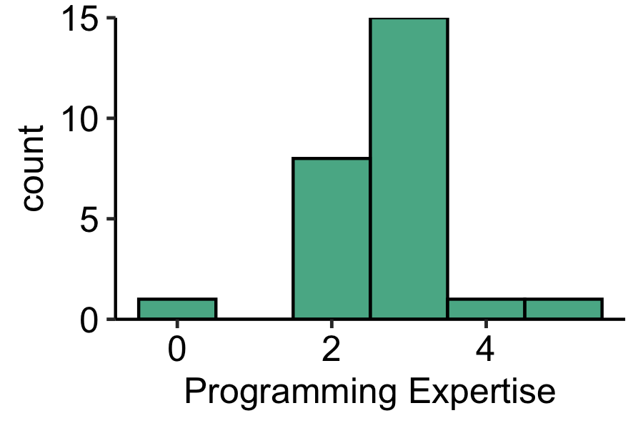
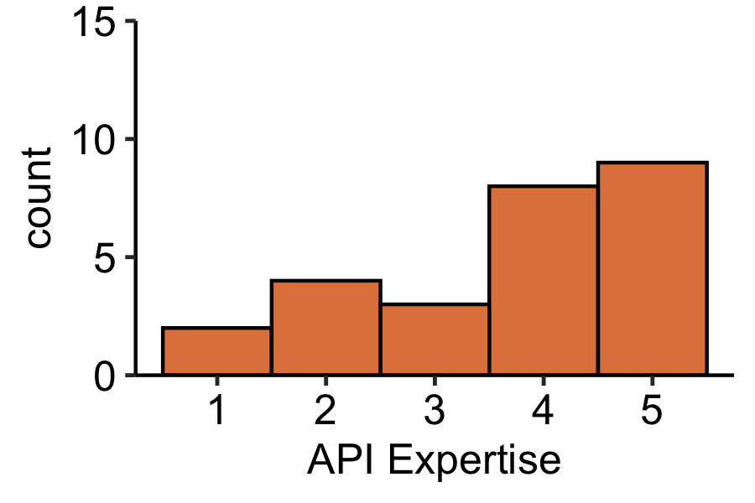
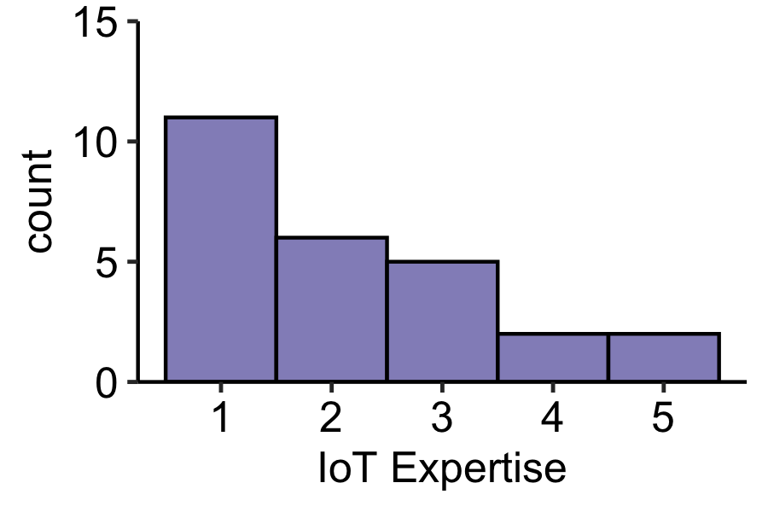
Evaluation – Procedure
Round robin allocation
classic – use native APIs to implement functionality
using holons – learn annotations and implement
Duration: up to 1 hour (+5 minutes intro)
Reward: £15 Amazon voucher
Recruitment: 26 participants
researchers, students, developers at campuses, local startups, incubators
Self-reported expertise levels:
Notes:
years, 5 is highest level of expertise
at Lancaster, Glasgow and Télécom SudParis

Slide 31
Results – Productivity
Average / median time to complete task
classic – 43.82 / 45.30
holons – 23.25 / 20.13
Level of improvement varies according to the level of programming expertise
Overall, we improve productivity by 47%

Slide 32
Results – Correctness
We manually inspected participant code for
correct usage of the required APIs
adherence to realizing the given workflow
Calculate percentage score
one point for each correct API
one point per milestone code statement
Average / median % correctness score
classic – 54.25 / 49.50
holons – 84.35 / 83.00
Overall, we improve correctness by 55%
Notes:
correctness score: calculated by assigning one point to each correct API and one point to the milestone code statement then the total was divided by the maximum number of points resulting is a score out of 100%.

